Slide 1
Multi-View Geometry
Lecture 4 of 4
Stereo camera depth estimation
Triangulation
PnP formulation
Avneesh Mishra

Slide 2
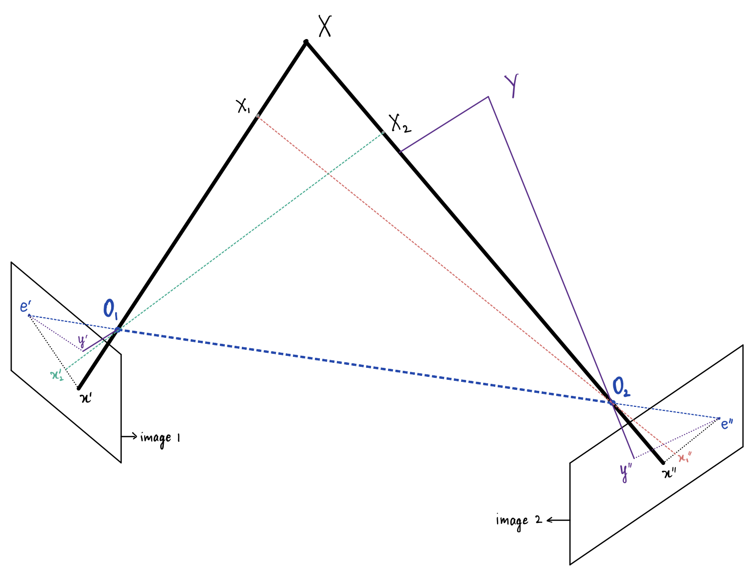
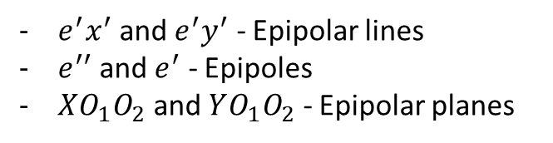
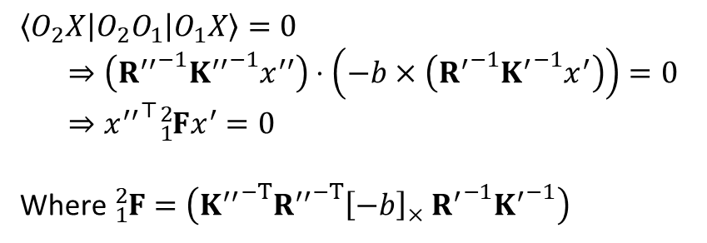
Epipolar Geometry
$e^{′}x^{′}$ and $e^{′}y^{′}$ - Epipolar lines
$e^{′′}$ and $e^{′}$ - Epipoles
$XO_{1}O_{2}$ and $YO_{1}O_{2}$ - Epipolar planes
$$\left\langle O_{2}X | O_{2}O_{1} | O_{1}X\right\rangle =0$$
$⇒\left({R^{′′}}^{−1}{K^{′′}}^{−1}x^{′′}\right)⋅\left(−b×\left({R^{′}}^{−1}{K^{′}}^{−1}x^{′}\right)\right)=0$
$$⇒{x^{′′}}^{⊤}{}_{1}^{2}Fx^{′}=0$$
Where ${}_{1}^{2}F=\left({K^{′′}}^{−T}{R^{′′}}^{−T}{\left[−b\right]}_{×} {R^{′}}^{−1}{K^{′}}^{−1}\right)$

Slide 3
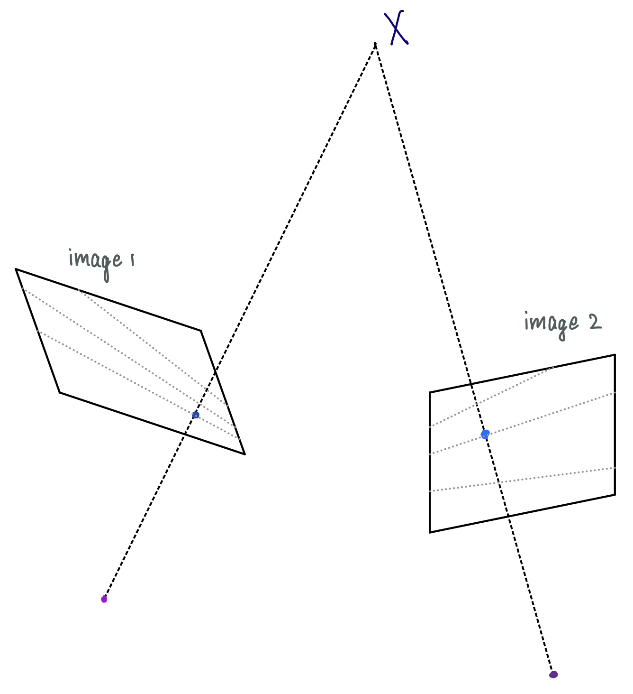
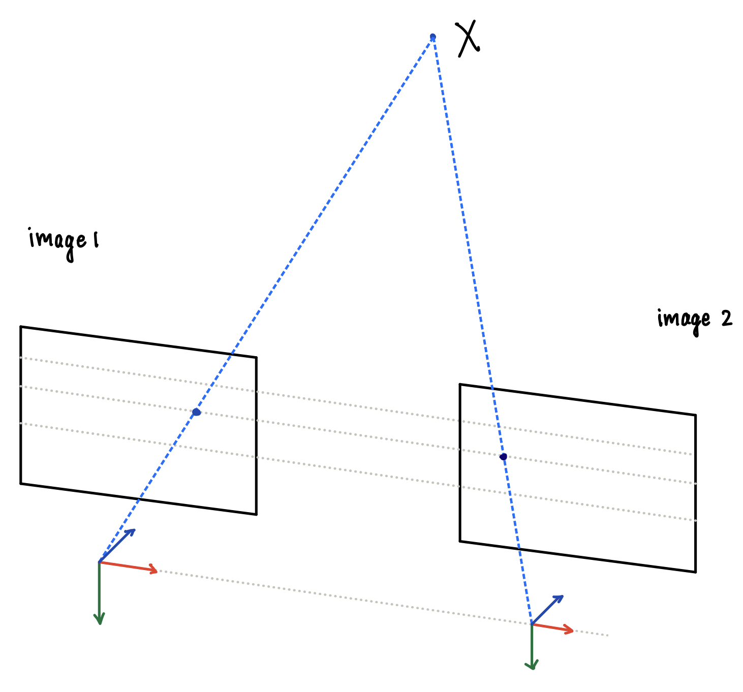
Stereo Rectification

Slide 4
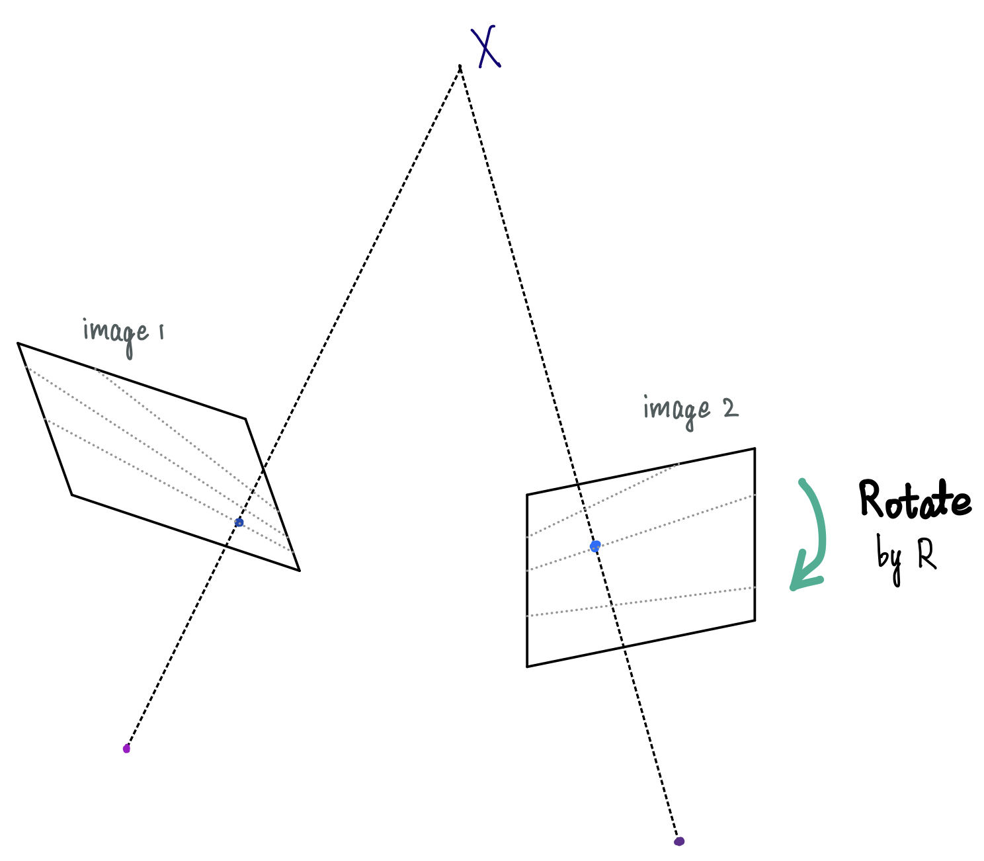
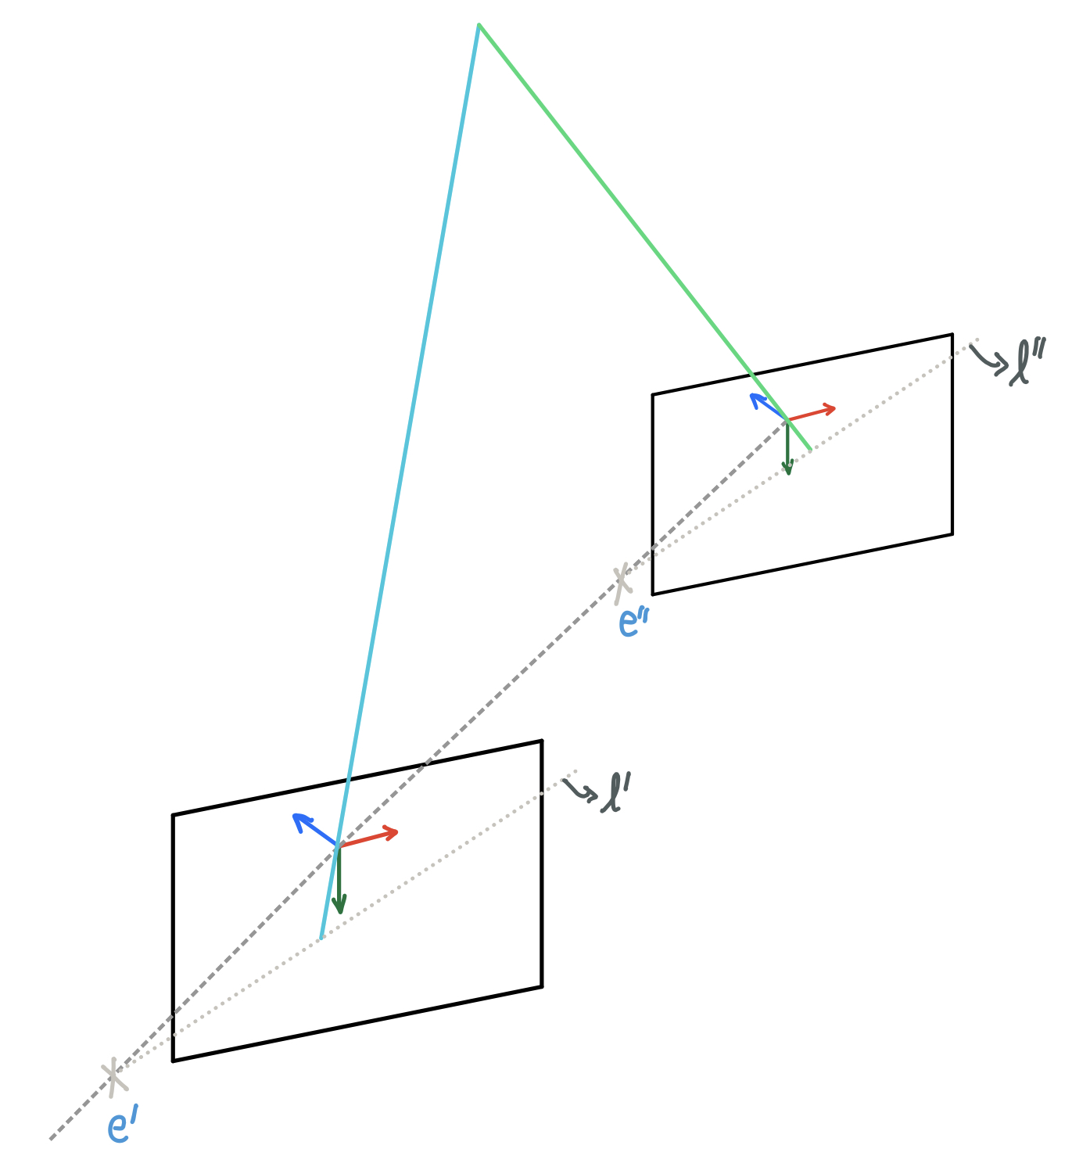
Stereo Rectification Steps
Fusiello, Andrea, Emanuele Trucco, and Alessandro Verri. "A compact algorithm for rectification of stereo pairs." Machine vision and applications 12.1 (2000): 16-22.

Slide 5
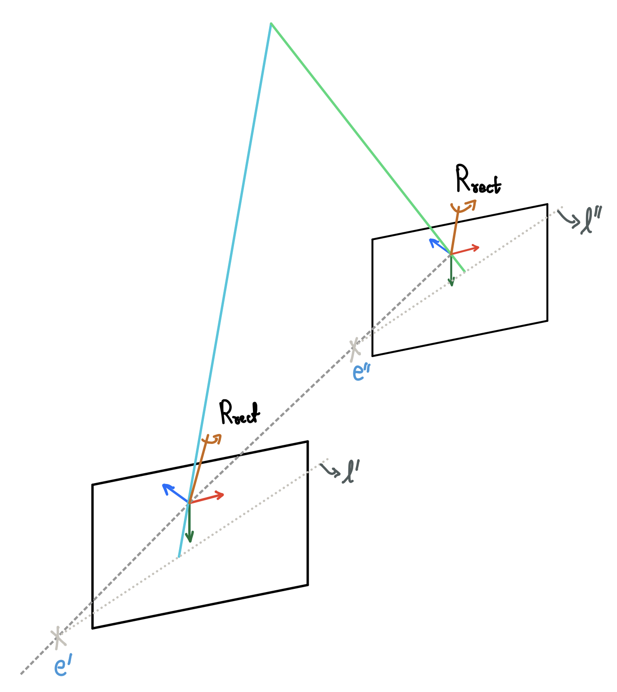
Stereo Rectification Steps
Fusiello, Andrea, Emanuele Trucco, and Alessandro Verri. "A compact algorithm for rectification of stereo pairs." Machine vision and applications 12.1 (2000): 16-22.

Slide 6
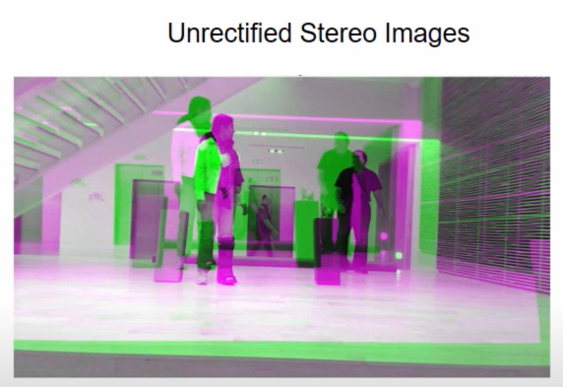
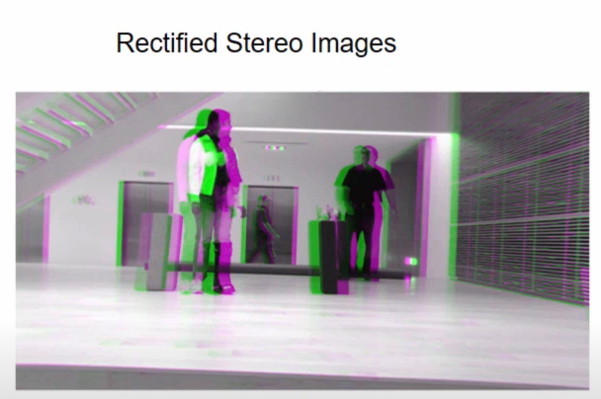
Stereo Pair Calibration and Rectification
Epipolar Geometry
docs.opencv.org
OpenCV Stereo Pair
C++: sourishghosh.com
Python: aliyasineser
stereoRectify
stereoRectifyUncalibrated
MATLAB YouTube
Stereo Vision
Camera Calibration

Slide 7
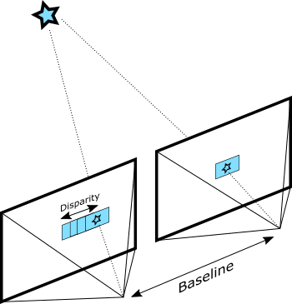
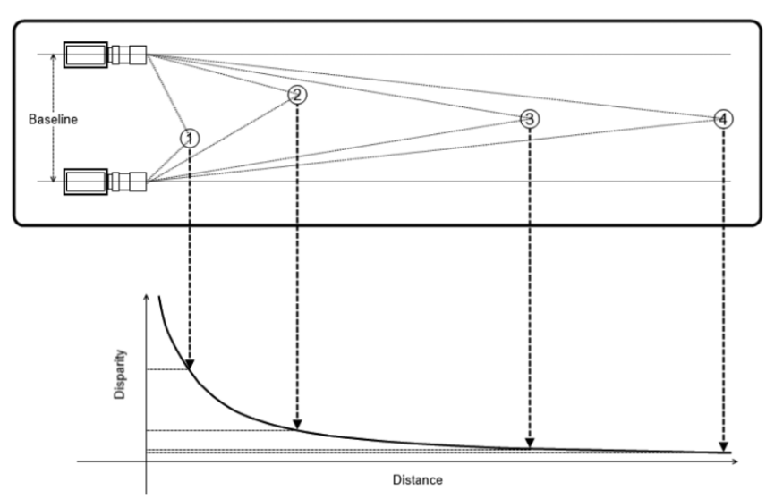
Stereo Depth Estimation

Slide 8
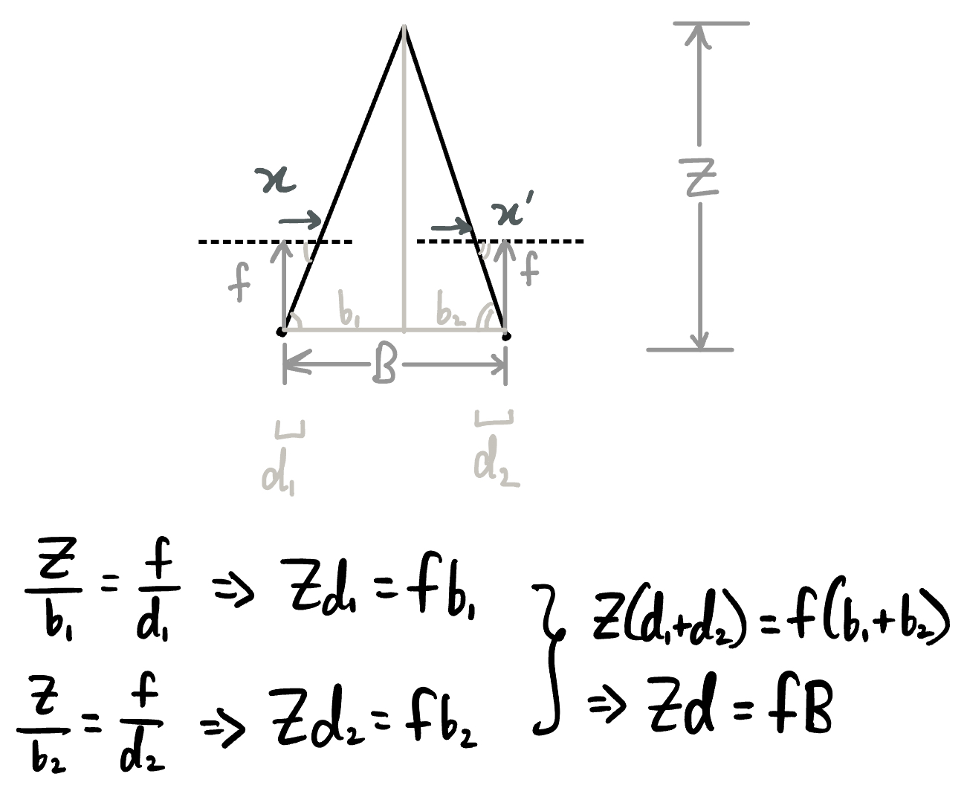
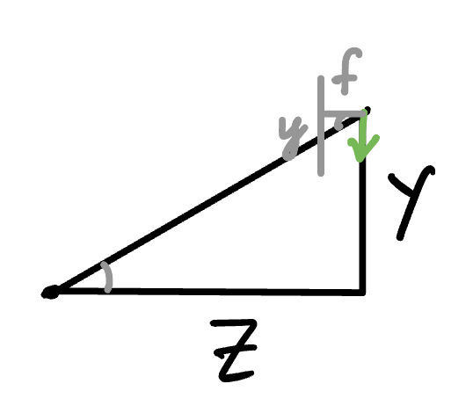
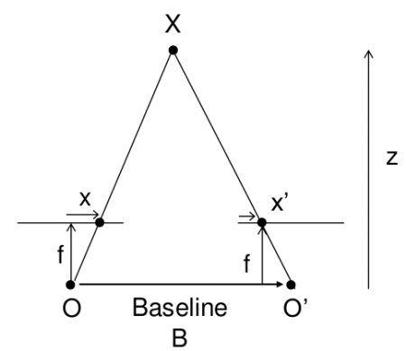
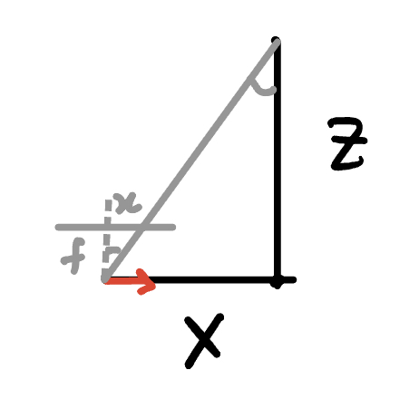
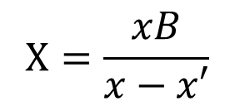
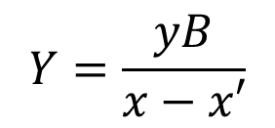
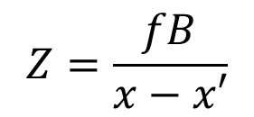
Depth (and point) From Disparity
$$Y=\frac{yB}{x−x′}$$
$$Z=\frac{fB}{x−x′}$$
$$X=\frac{xB}{x−x′}$$

Slide 9
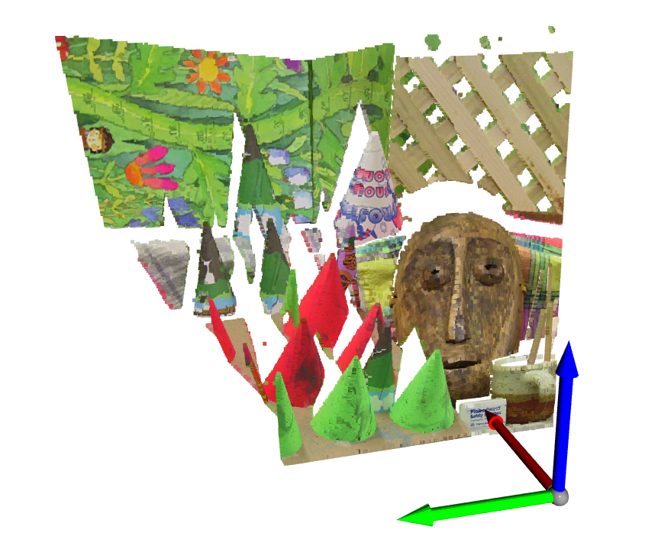
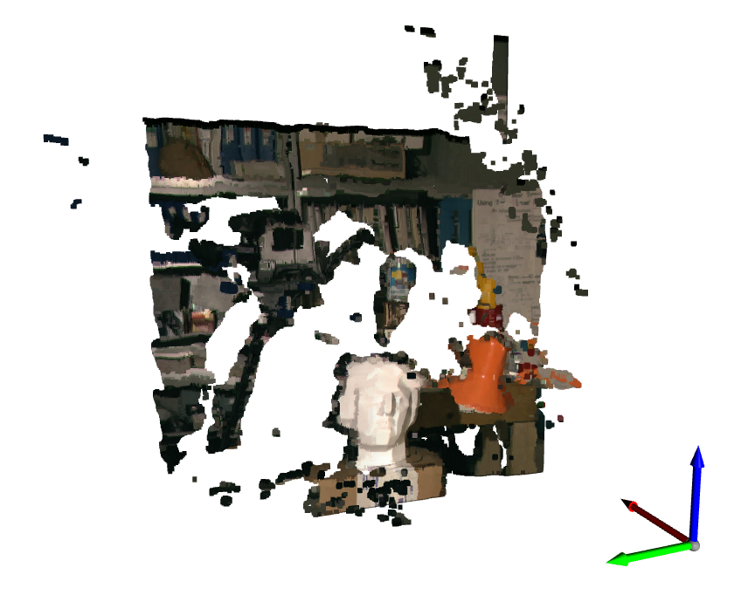
Code!

Slide 10
References
https://www.intelrealsense.com/stereo-depth-vision-basics/ – Start with code
https://learnopencv.com/depth-estimation-using-stereo-matching/ – Overview with ML approaches
https://medium.com/analytics-vidhya/distance-estimation-cf2f2fd709d8 – Conceptual overview
https://learnopencv.com/depth-perception-using-stereo-camera-python-c/ – Advanced (C++, with configs)
Some brief questions…

Slide 11
Stereo camera depth estimation
Triangulation
PnP formulation

Slide 12
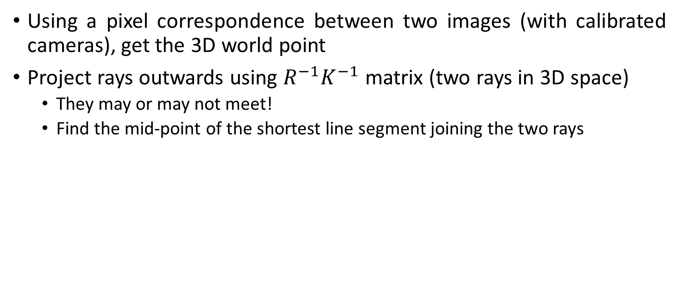
Triangulation
Using a pixel correspondence between two images (with calibrated cameras), get the 3D world point
Project rays outwards using $R^{−1}K^{−1}$ matrix (two rays in 3D space)
They may or may not meet!
Find the mid-point of the shortest line segment joining the two rays

Slide 13
References
Triangulation on Wikipedia
Group triangulation on OpenCV through SFM
Understand camera intrinsic matrix on towardsdatascience
R Hartley and A Zisserman (2013) - Multiple View Geometry in computer vision. ISBN 978-0-521-54051-3.
Some brief questions…

Slide 14
Code!

Slide 15
Stereo camera depth estimation
Triangulation
PnP formulation

Slide 16
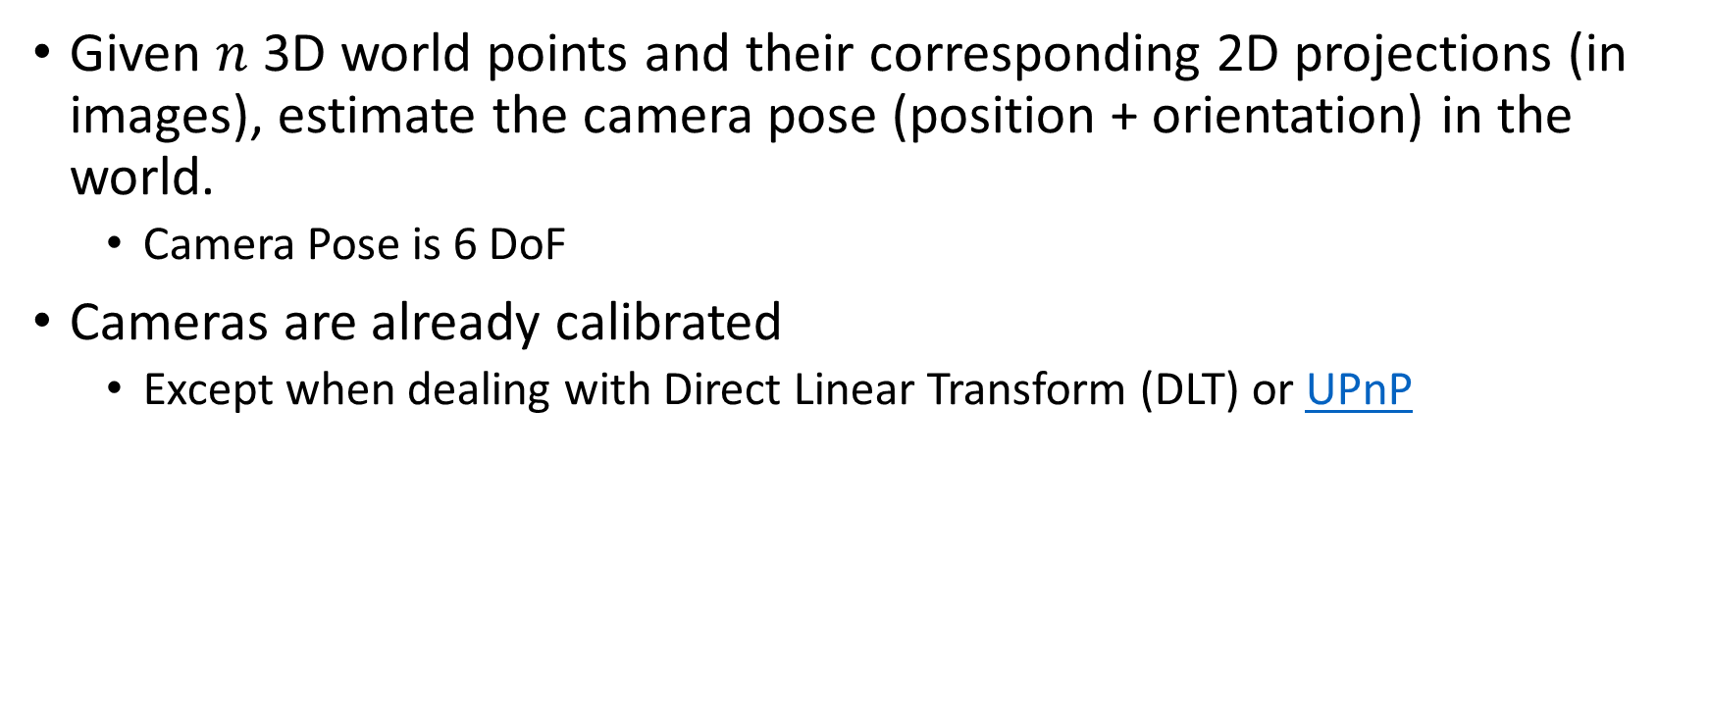
Perspective-n-Point (PnP)
Given $n$ 3D world points and their corresponding 2D projections (in images), estimate the camera pose (position + orientation) in the world.
Camera Pose is 6 DoF
Cameras are already calibrated
Except when dealing with Direct Linear Transform (DLT) or UPnP

Slide 17
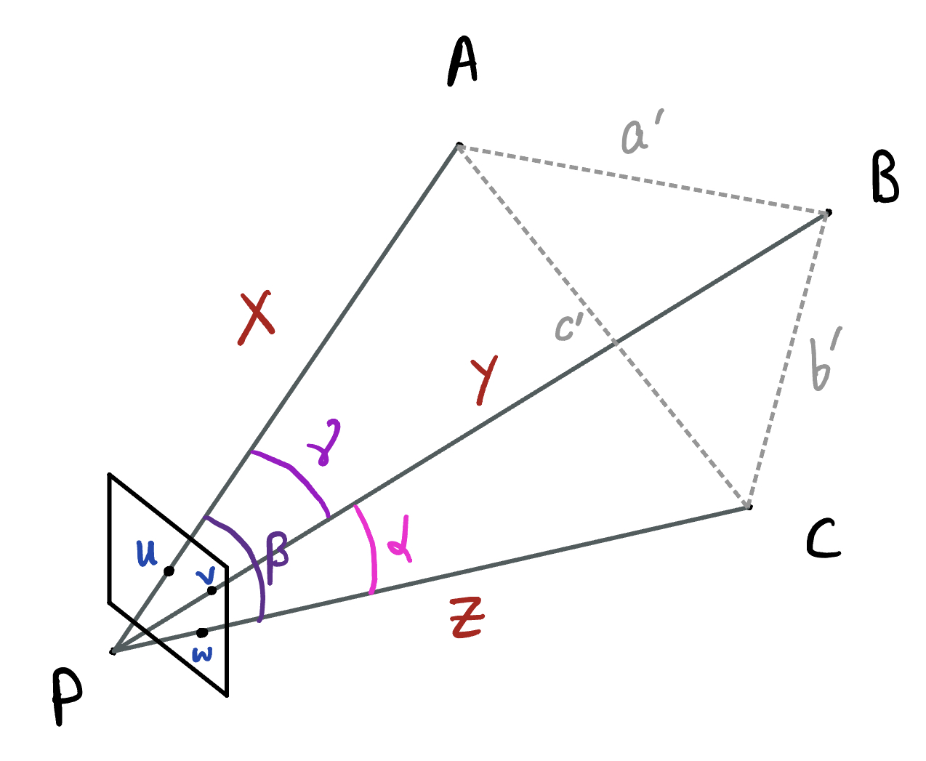
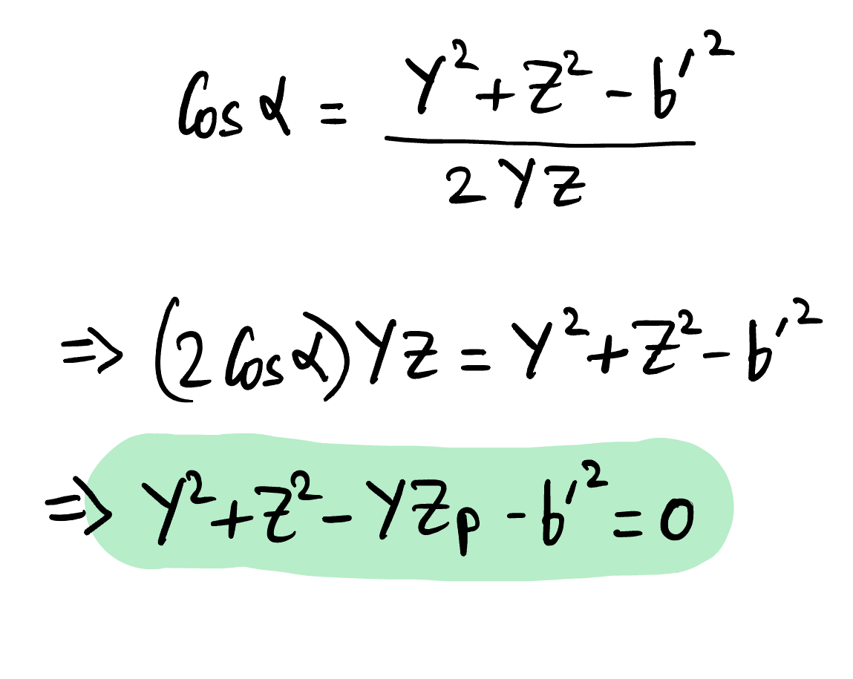
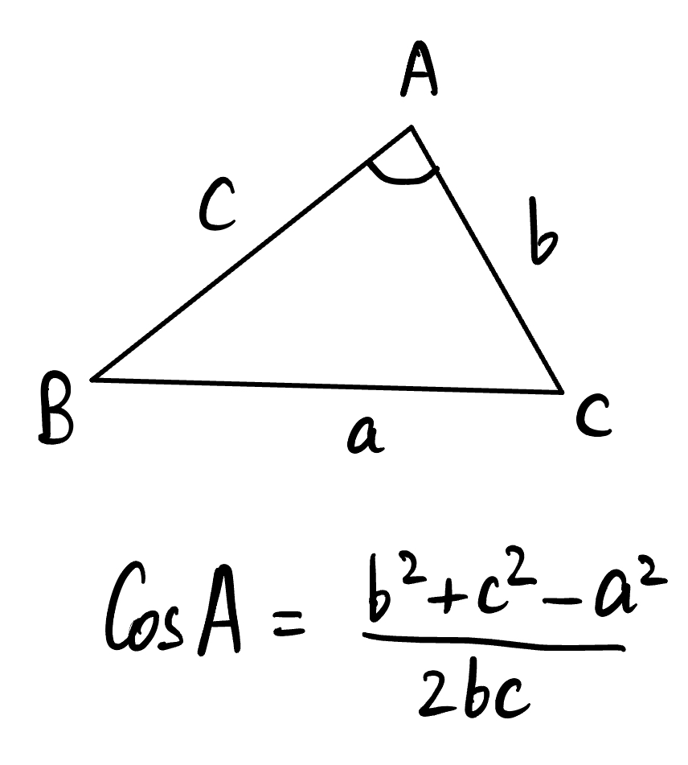
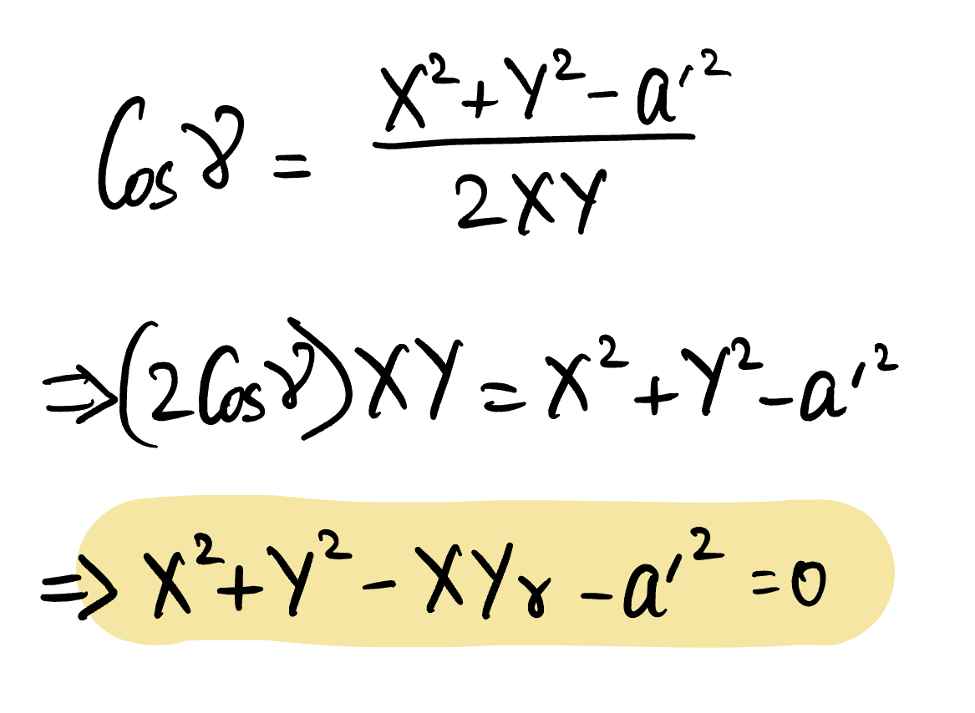
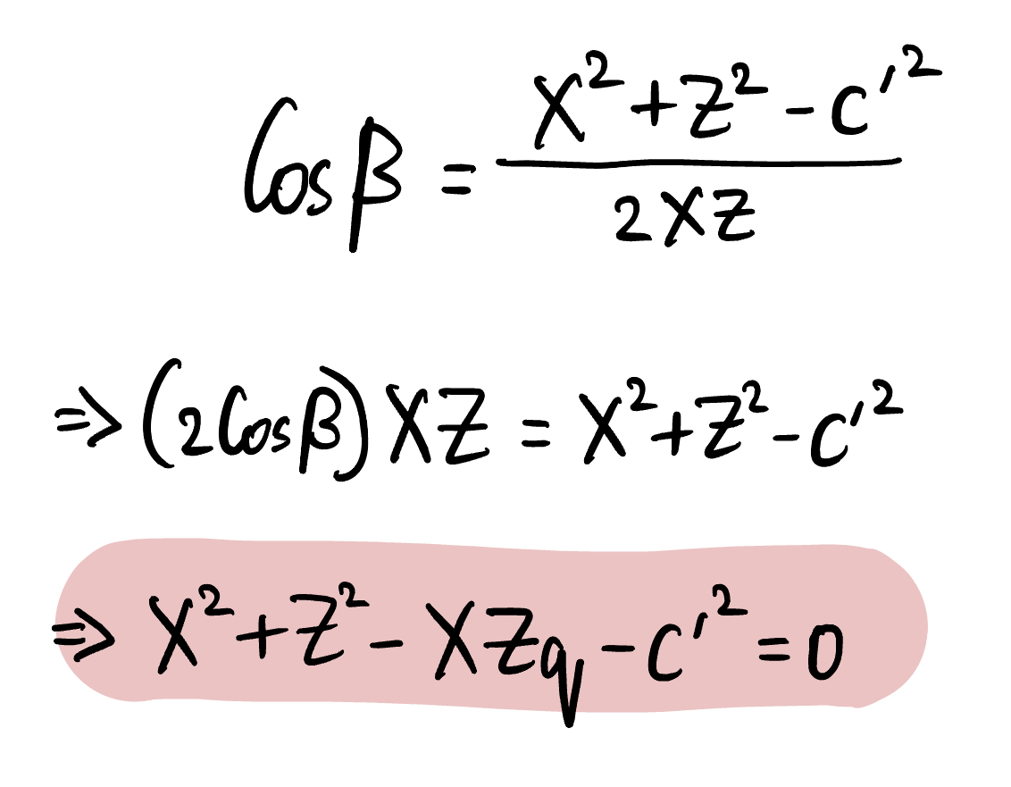
PnP Briefly
3 equations, 3 unknowns. However, there could be multiple forms of solutions (4 actually)

Slide 18
References
Earliest works (1999): Linear N-Point Camera Pose Determination
Recent solution (2003): Complete solution classification for the perspective-three-point problem
Faster and more accurate (2018): Lambda Twist: An Accurate Fast Robust Perspective Three Point (P3P) Solver
Efficient O(n) PnP (2009): EPnP: An Accurate O(n) Solution to the PnP Problem
OpenCV tutorial

Slide 19
Thank You!

